Slide 1
A Laboratory to Teach Laser and Atomic Physics
Joseph E. Wiest
West Virginia Wesleyan College
AAPT Conference – Cincinnati 2017

Slide 2
Course Description
Name: Electro-Optics (Laser Physics)
Number: PHYS 305L
Level: Junior
Time: Three hours per week
Text: “ A Laser Laboratory Guidebook”, Joseph E. Wiest
Pre-requisite: PHYS 210 Light and Atomic Physics
When offered: Each semester
Enrollment: 12 – 14 per semester
Founding date: About 1985

Slide 3
Pertinent Physics Principles to Be Taught
Quantum oscillator model
Quantum atomic model
Nuclear shell model
Doublet and hyperfine structure of the atom
Physical optics concepts
Operating principles of gas, solid state, and dye lasers
Molecular structure
Molecular dynamics
Bethe-Weizsacker mass equation/nuclear stability

Slide 4
Experimental Objectives
History, development, and applications of the laser
Doublet and hyperfine structure of the alkali metal elements
The acousto-optic effect
Bond strength of the linear molecule
The pumped tunable dye laser
Raman effect in polymers
Frequency doubling in crystals
Stable isotopes of elements

Slide 5
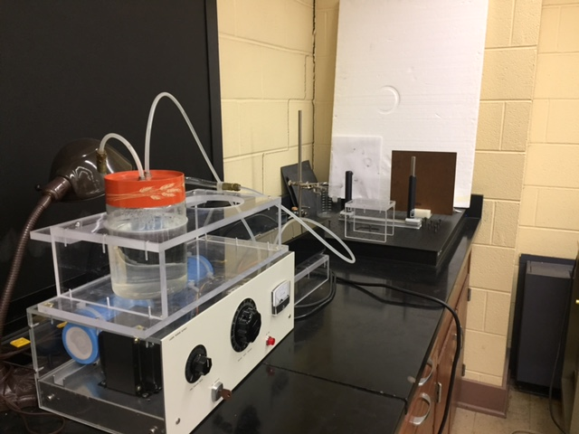
The Ruby Laser

Slide 6
Helium-Neon Lasers

Slide 7
The Nitrogen Gas and Liquid Dye Lasers

Slide 8
The AlGaAs Tunable Diode Laser

Slide 9
The External Grating Tunable Diode Laser

Slide 10
The Carbon-dioxide Laser

Slide 11
Nd-YAG and InGaN Lasers

Slide 12
The Ruby Laser Experiment – 693 nm

Slide 13
Rubidium Experiment – 780 nm and 795 nm

Slide 14
Cesium Experiment -- 852 and 894 nm

Slide 15
The Iodine Molecular Bond Experiment

Slide 16
ND-YAG Excitation of the Iodine Molecule

Slide 17
The Krypton Optogalvanic Experiment

Slide 18
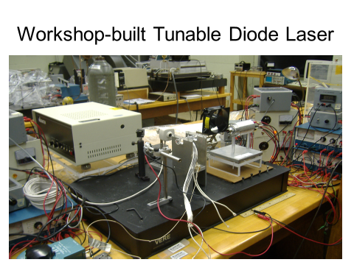

Slide 19
The Temperature-Tunable Diode Laser
Cathode
Anode

Slide 20
Calibration of the AlGaAs Tunable Laser

Slide 21
Rubidium 780 nm Line Data
Intensity (mV)
Laser Injection Current (mA)

Slide 22
Rubidium 795 nm Line Data

Slide 23
Hyperfine Splitting of the 852 nm Line in Cs
852.338 nm
Intensity
(mV)
Piezo Voltage (V)

Slide 24
Hyperfine Splitting of the 894 nm Line in Cs
Intensity (mV)
Injection Current (mA)

Slide 25
Nuclear Energy Levels – Maria Goeppert Mayer – for ¹H , ⁷Li , ²³Na , ³⁹K , ⁸⁵Rb , ¹³³Cs
8 Cs + 22 above 5 Cs 1g7/2
8 Rb 10 Cs 10 Cs 1g9/2
2 Rb 2 Cs 2 Cs 2P1/2
6 Rb 6 Cs 5 Rb 6Cs 1f5/2
4 Rb 4 Cs 4 Rb 4Cs 2P3/2
8 Rb 8 Cs 8 Rb 8Cs 1f/7/2
4 K 4 Rb 4 Cs 3 K 4 Rb 4 Cs 1d3/2
2K 2 Rb 2 Cs 2 K 2 Rb 2 Cs 2S1/2
4 Na 6 K 6 Rb 6 Cs 3 Na 6 K 6 Rb 6 Cs 1d5/2
1 Li 2 Na 2 Rb 2 Cs 2 Na 2 K 2 Rb 2 Cs 1P1/2
4 Li 4 Na 4 K 4 Rb 4 Cs 1 Li 4 Na 4 K 4 Rb 4 Cs 1P3/2
2 Li 2 Na 2 K 2 Rb 2 Cs 1 H 2 Li 2 Na 2 K 2 Rb 2 Cs 1S1/2
Neutrons Protons

Slide 26
Rubidium - 85 Doublet and Hyperfine Levels
Atomic energy state of J = 1/2 , Nuclear state = 5/2 :
F = Net atomic state = I ( Nuclear state ) + - J ( Atomic state ) F =
= 5/2 +- 1/2 = 2 , 3 F = 4
3 Atomic energy state of J = 3/2 : 5P_{3/2} 2
5P1/2 3 1
F = 5/2 +- 3/2 = 1 , 2 , 3 , 4 780 nm 2
795 nm 3 3
Transition rules: 5S_{1/2} ΔL = +- 1 ΔF = 0 , +- 1
2 2

Slide 27
Cesium -- 133 Doublet and Hyperfine Levels

Slide 28
Hyperfine Energy Level Splitting (Steck)
The Hamiltonian
H_{hfs} = A_{hfs}I◦J +
B_{hfs} (3(I◦J)2+3/2(I◦J)-I(I+1)J(J+1))
2I(2I-1)J(2J-1)
A_{hfs} = Magnetic dipole constant
B_{hfs} = Electric quadrupole constant
(J>1/2)

Slide 29
Calculating Hyperfine Energy Splitting (Steck)
∆E_{hfs} = (1 /2) A_{hfs}K + B_{hfs} {[(3/ 2)[K(K + 1) − 2I(I + 1)J(J + 1)]/[ 2I(2I − 1)2J(2J − 1)]}
where K = F(F + 1) − I(I + 1) − J(J + 1)

Slide 30
Hyperfine Splitting Measurements
Rubidium : Measurement (nm) Accepted Value (nm) % Diff
(Rb-85) 780.652 780.238 .0531
780.712 780.244 .0600
794.959 794.975 .00201
794.965 794.982 .00214
Cesium: 852.338 852.335 .000352
(Cs-133) 852.361 852.357 .000469
893.722 894.579 .0958
893.744 894.603 .0960

Slide 31
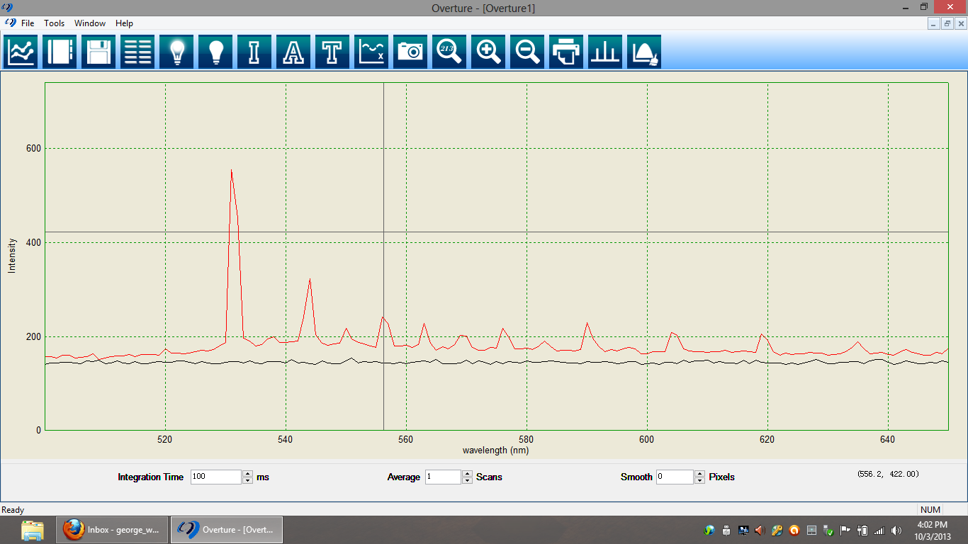
Spectrum of Iodine Molecule Excited by Frequency-Doubled Nd:YAG Laser

Slide 32
The Birge – Sponer Plot

Slide 33
Calculations from the Data; Harmonic Oscillator Model
K = m ( 2πcω₀ )²
= 127x1.6605x10⁻²⁷ /2 x (2π x 2.9979x10⁸ x 2.198x10⁴)²
= 180.7 N/m (Our result)
K = 172.1 N/m (Bayram And Freamat)

Slide 34
Raman Scattering (Nylon) – Rayleigh Peak

Slide 35
Raman Scattering (Nylon) – Stokes Peak

Slide 36
Raman Scattering (Nylon) – Anti-Stokes Peak

Slide 37
The Stable Isotopes of Krypton

Slide 38
WV Wesleyan Physics Senior Class 2016-2017

Slide 39
Conclusions
Course reviews and reinforces concepts of previous year classes in light, atomic, and nuclear physics.
Students are prepared to do funded summer research work on our campus or other involving laser/atomic physics.
Graduates report experience from course has facilitated good graduate research assignments.
Graduates report good use of concepts and techniques of course in both physics and engineering graduate study.
Hands-on experience and research techniques encountered in course have provided excellent preparation for the year of senior research.

Slide 40
Acknowledgements
NASA – WV Space Grant Consortium
West Virginia Wesleyan College
Aaron Weaver, (Wesleyan 2015, now grad Physics at WVU)
Mackenzie Robatin and Gabrielle Cox, Summer Research 2017
Students in the Electro-Optics Classes of 1993 to 2017
SURE Grant Program
Robert Grose for machining; Tracey Delaney for computer and technical help
Dr. G.S. Hurst, Oak Ridge National Laboratory

Slide 41
References
1. S.B.Bayram and M.V.Freamat, “Simple Laser-Induced Fluorescence Setup to Explore Molecular Spectroscopy”, Compadre.Org /advlabs/bfy/files/W31, 1-8 (2012).
2. Livesey, Derek, Atomic and Nuclear Physics (Ginn and Blaisdell, Toronto, 1966).
3. Serway, Moses, Moyer, Modern Physics (Thomson-Brooks/Cole, Belmont, CA, 2005).
4. Steck, Daniel, Dept. of Physics, Univ. of Oregon, Rubidium 85 D Line Data, 2013.
5. Steck, Daniel, Los Alamos National Laboratory, Cesium 133 D Line Data, 2003.
6. Derek Eastham, Atomic Physics of Lasers (Taylor and Francis, 1986).
7. H.Haken and H.C. Wolf, Atomic and Quantum Physics (Springer-Verlag, 1984).
8. C.J. Foot, Atomic Physics (Oxford Press, 2005).
9. David Van Baak, Physics Dept., Calvin College, 1993.

